Slide 1

Car Rental and Buying System
By:
Narayana Mrunal
Devansh Srivastava
Hrithik Anilkumar Sharma
Chethan S
Varsha H P
Under guidance of:
Ms. Tandra

Slide 2
Contents
Introduction
Database of Car rental and buying
Modules of the project
Conclusion
Reference

Slide 3
Introduction
CAR RENTAL AND BUYING SYSTEM (CRBS) is a web-based system for a company that rents out and buy cars.
This system enables the company to make their services available to the public through the internet and also keep records about their services.
.

Slide 4
Kar Kiraya.
Kar kiraya application changes its menu according to the time .
Kar kiraya IS COMPLETELY CUSTOMER CENTRIC.
​Kar Kiraya is a car rental and buying application , known for its user friendly features.

Slide 5
Database
Kar Kiraya is an car rental and buying platform. This system will allow you to choose the option of buying or renting which increases the scope of business by reducing the labour cost involved .
The system allows users to quickly and easily manage an online menu of cars available which customers can browse and use to place orders with a just few clicks.
The application greatly simplifies the renting and buying process for the customer.

Slide 6
Goals of Project
To produce a complete online solution to bridge the gap between showrooms and the user.
To provide increased convenience and transparency to both users and clients.
To increase returning customers
To provide abundant employment opportunities.
To become available to small – scale business as well.

Slide 7
Proposed System
Database to store user profiles , cars available
Adding features including user sign up flow , sign in flow , car search , buy or rent a car adding car to the list to buy or rent.
Provide list of order placed.

Slide 8

Requirements
Functional requirements
The system shall enable the admin to view, create, edit, and delete the cars.
The system allow generation of reports for the order placed.
The system shall allow the admin to update additional information for a given car.
The system shall enable the customer to view the products menu , create an account , login to the system, and place an order.
The system shall provide visual confirmation of the order placement.

Slide 9
Non- functional Requirements
There should be sufficient network bandwidth
Maintaibility – easy to mainatian
Performance / response time – fast response.
Usability by target user community – easy to use
Expandibility needs to be future proof or upgradable
Safety – should be secure to use

Slide 10

Modules of Kar Kiraya

Slide 11
Modules of Kar Kiraya
Registration and login page for user
User login page to perform operation on buy or rent a car
Main page for displaying cars available and cars not available .
Showing orders placed by user

Slide 12
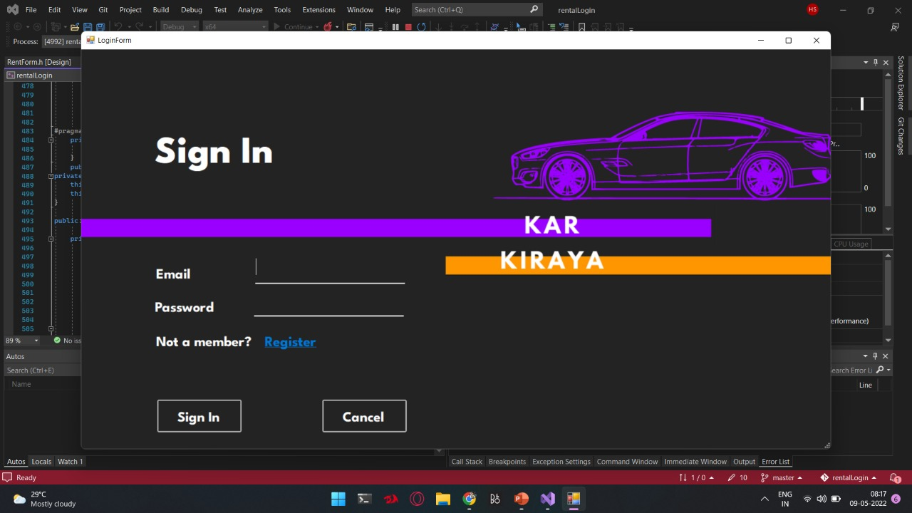
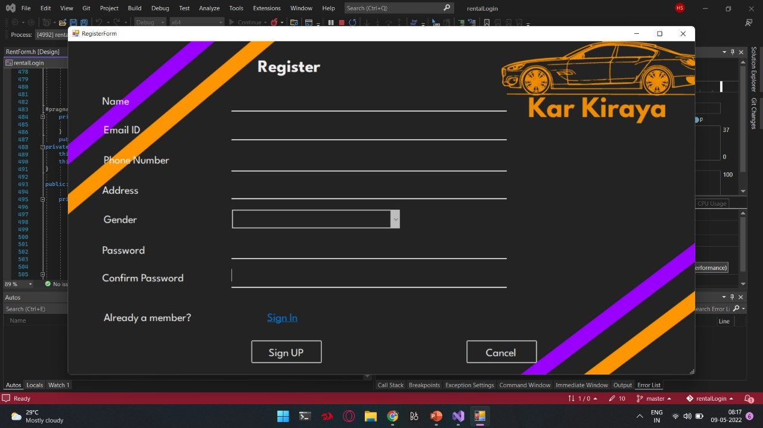
Registration and login page for user

Slide 13
Registration form enables users to access the application
For using “KAR KIRAYA” user has to signup or register to the application by filling details .
Details such as :
Name
E-mail
Password
Mobile Number
Gender
Once the user has registered with the above given details and on submit the user will be directed to the login page.

Slide 14
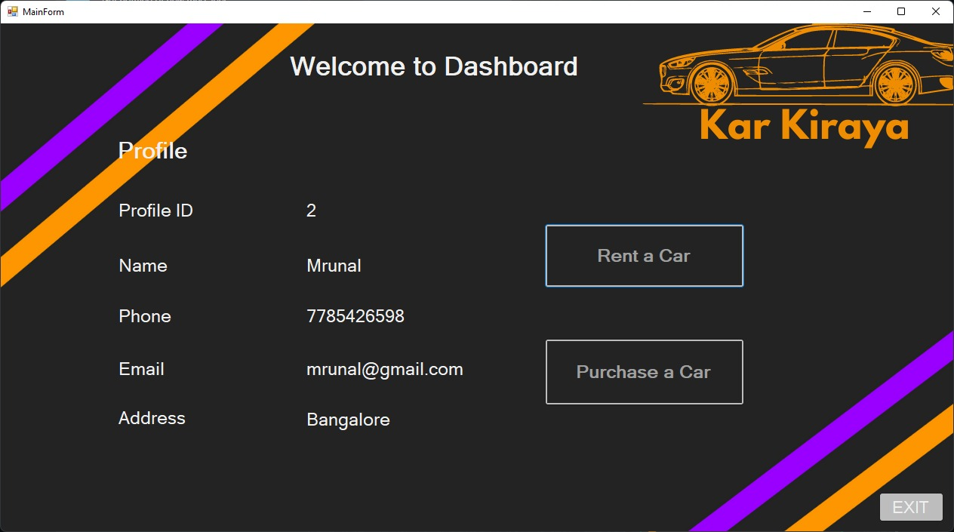
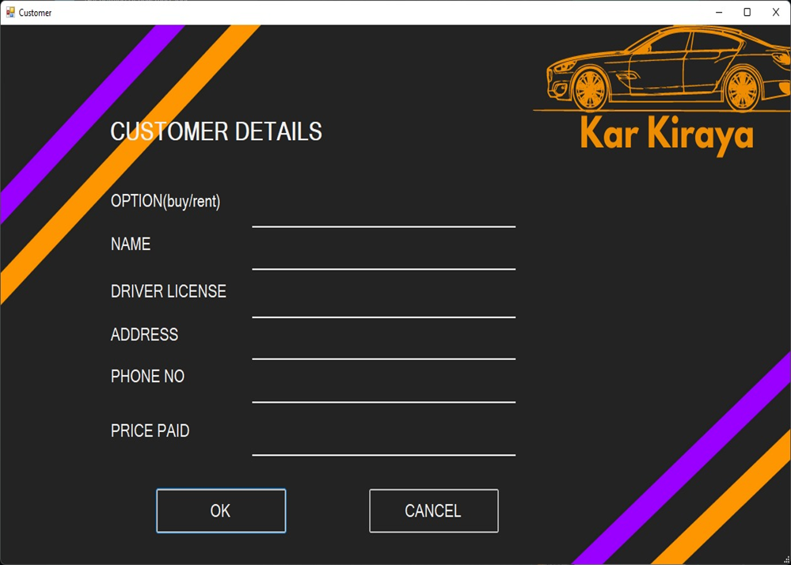

Slide 15
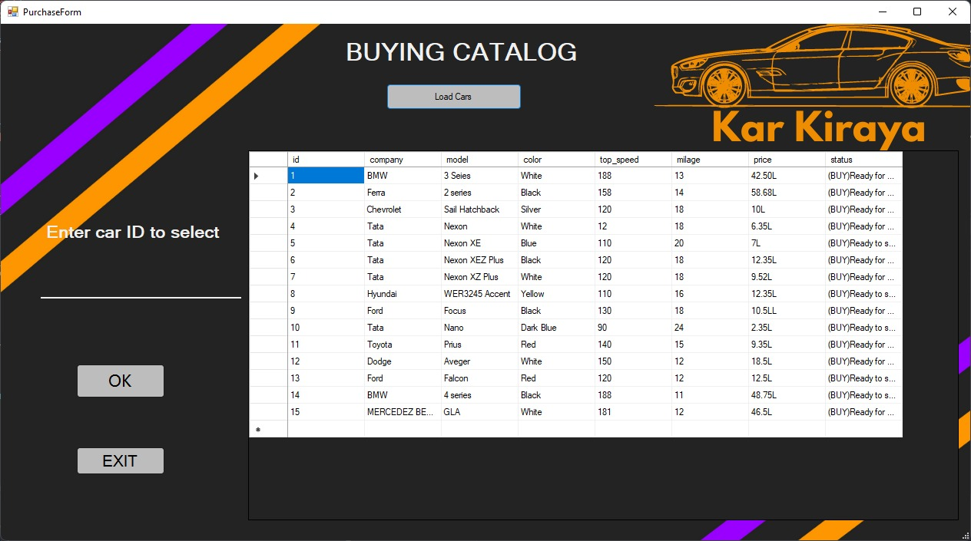
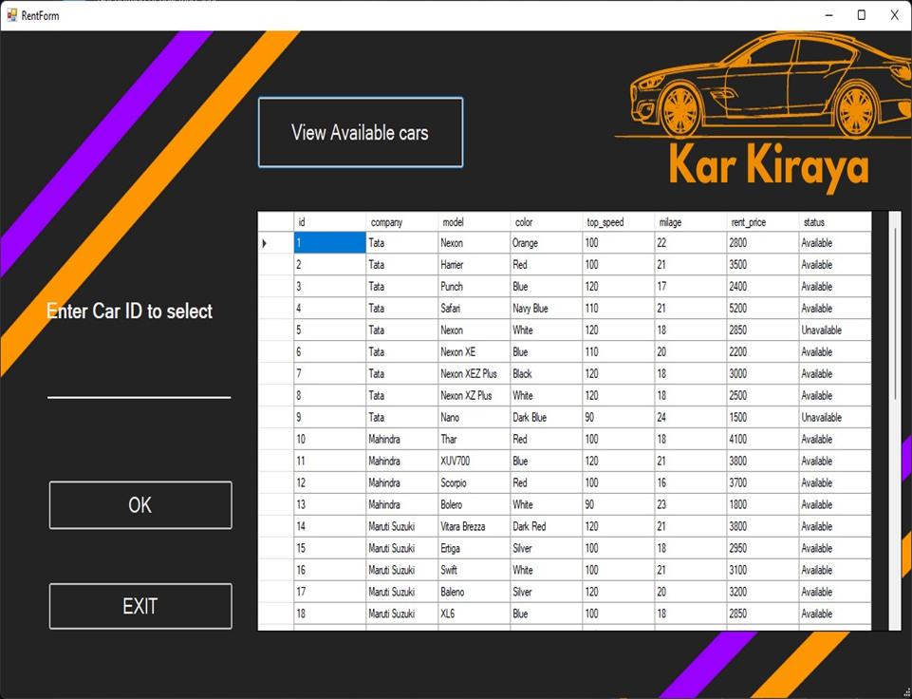
Buying Catalog

Slide 16
Testing
Test cases
User login
User registration
Selecting the car required
Adding car to the list
Placing order and checking status of order placed
CRUD operations by admin
Car delivery to the user

Slide 17
Conclusion
Kar kiraya is a web application which is used to buy or rent a car at a time.
1
Using this application, the end users register online, read the list of cars available and select the car of there need from the list and confirm the order.
2
In conclusion kar kiraya stores the data of each and every car. It makes easier for the user to place the car oder.
3

Slide 18
THANK YOU

